Slide 1
Two-Year Master's Degree in INTERNATIONAL RELATIONS
Department of Political and Social Sciences

Slide 2
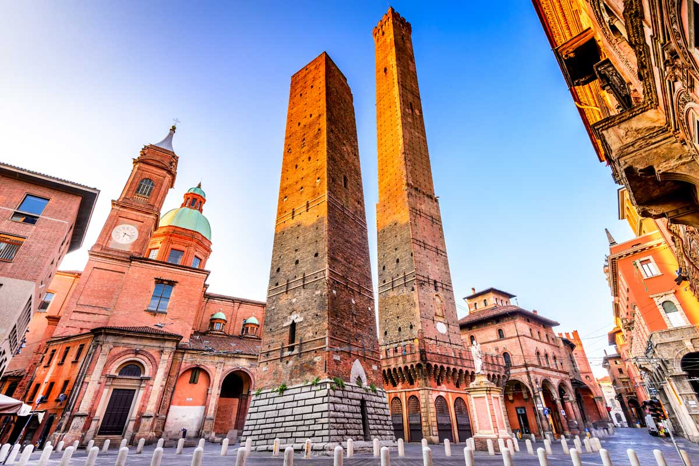
MASTER’S DEGREE IN INTERNATIONAL RELATIONS
Bologna campus
2 years (120 CFU/ECTS)
Intake: 140 students (110 spots for Italian/EU nationals, 30 for non-EU nationals/residents)​
Different academic backgrounds welcomed. Provided that you meet certain
requirements (listed in the Call for Applications). ​
International, interdisciplinary programme, offering numerous opportunities: Double degree, exchanges and internships
Internationally recognised Master’s Degree. Bear in mind that in the Italian university system, there’s no distinction between MA/MSc. You will obtain a “Laurea Magistrale”, which, outside of Italy, is recognised simply as a “Master’s Degree”.

Slide 3
BEFORE WE BEGIN…
Leave your questions in the chat! Questions will be answered at the end of the presentation
Join us at 4pm for the Student Café to hear the testimonies from our students and recent graduates.
Notes:
ALE & VIC

Slide 4
THREE CURRICULA
International Affairs (IA)
Focus on geopolitical strategies, conflict mediation and security policies
Various courses from different fields: politics, economics, history and area studies, sociology, law
European Affairs (EUA)
Focus on EU integration politics, policies, and institutions
Courses from 4 macro-areas: political science, economics, area studies and European politics and institutions
Crime, Justice and Security (CJS)
Focus on transnational crime, its impacts on (inter)national security and related law enforcement policies
Various courses from different fields: politics, sociology, criminology. Special focus on legal theory and analysis
Notes:
ELE

Slide 5
STRUCTURE - YEAR 1 (based on a.y. 2023/24)
Y E A R 1 | International Affairs | European Affairs | Crime, Justice, and Security
 | Evolution of the International System
 | Research Methods
 | Political Science field - 1 course | Politics of European Institutions | Politics, Violence and Crime
 | History field - 1 course | Europe in World Politics | History of Globalisation and Crime
 | 1 among listed courses | EU Constitutional Law | Sociology field - 1 course
 | Economics field - 1 course
 | Language course (French, Spanish or German)
 | Data Science Workshop
Mandatory courses
Elective courses
Language course
Workshop
For curriculum IA, multiple «Tracks» by different combining courses:
e.g. Data and Cybernetics for IR; War and Peace in IR; Economics and Environment in IR

Slide 6
STRUCTURE - YEAR 2 (based on a.y. 2022/23)
Y E A R 2 | International Affairs | European Affairs | Crime, Justice, and Security
 | THESIS
 | Workshop
 | History field - 1 course | 1 among listed courses | 1 among listed courses
 | 1 among listed courses | 2 among listed courses | 1 among listed courses
 | 1 among listed courses |  | 1 among listed courses
 | Free credits - electives, internship(s), JHU elective course, etc.
Master’s Thesis
Elective courses
Free credits
Workshop
More on the structure of each curricula: course’s website → studying → course structure diagram

Slide 7
OPPORTUNITIES
Unibo-JHU Double Degree
1st year: RILM Programme at Unibo (Bologna campus)
2nd year: MAIA Programme at JHU SAIS Europe (Bologna campus)
More on the RILM-MAIA Double Degree
Study abroad
Erasmus+ – Spend one or two semesters at another European university
Overseas – Spend one or two semesters at a non-European partner university
More on Erasmus+, Overseas, and other study abroad experiences
Internships
Curricular internship (in Italy or abroad) – e.g., MAECI-CRUI
Erasmus+ Traineeship (in Europe)
Internship abroad in preparation of your thesis
More on internships
Notes:
ELE

Slide 8
ADMISSION REQUIREMENTS
Bachelor’s Degree or students currently enrolled in a BA/BSc
Academic merit (GPA)
Congruence with academic background
You’ll be able to apply if you’re about to get a degree
2) CV
Academic titles and language certificates
Study abroad experiences – e.g., Erasmus, Overseas, etc.
Relevant experiences – e.g., jobs, internships, volunteering, etc.
3) B2 English Language Certificate or above
Call for Applications 2024/2025* is published here: https://corsi.unibo.it/2cycle/InternationalRelations/how-to-enrol.
Remember: Fill the Application Form and Upload it!
*This document will be your main and official reference.

Slide 9
TUITION FEES
Fees are calculated progressively, based on the 2024 ISEE value (≃ income).
More on tuition fees at https://www.unibo.it/en/teaching/enrolment-transfer-and-final-examination/tuition-fees-and-exemptions
Grants (e.g. ER.GO) and exemptions (e.g., merit, disability,
refugee status)​.
More on Grants and Exemptions

Slide 10
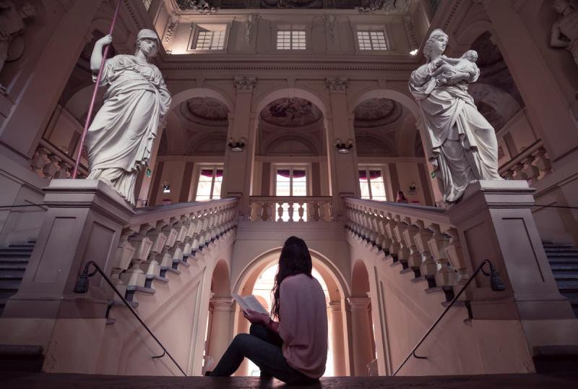
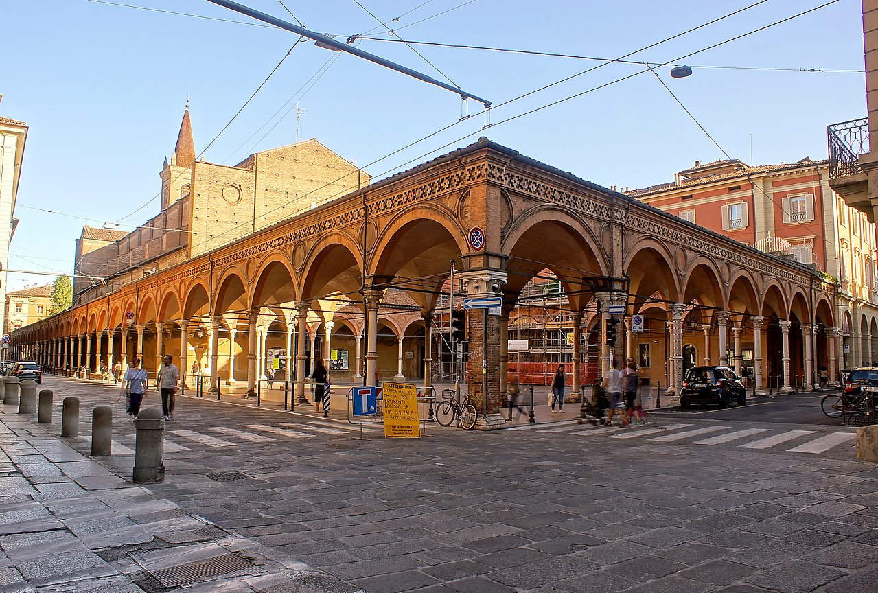
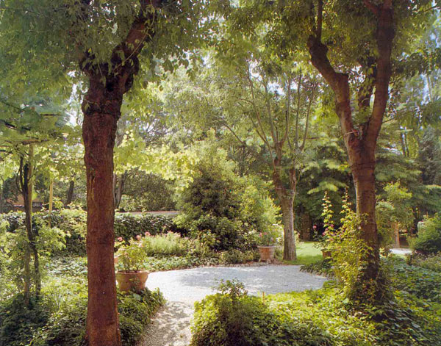
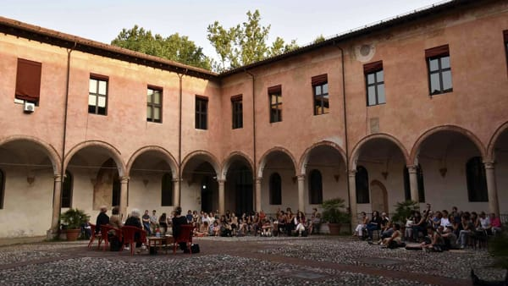
STUDY IN A CULTURAL AND HISTORICAL HUB: some iconic places of our University
Palazzo Hercolani
Portico dei Servi
Aula Magna
Santa Lucia
Hercolani Secret Garden
Convento Santa Cristina
Have a virtual tour of some of the most renowned historical premises of the University of Bologna:
https://www.unibo.it/en/university/who-we-are/virtual-tour-of-several-sites-of-the-university-of-bologna

Slide 11
Collegio Superiore: an institution of excellence
An interdisciplinary and multi-sectoral educational programme
What it is
An interdisciplinary and multi-sectoral educational programme
Who it is for
Talented and committed students enrolling in a Master's degree programme
What you get
Upon completion of the Ordinary Humanistic-Social or Scientific-Technological Course (24 credits), you are awarded the Diploma of the Collegio Superiore.
What it provides
a high-profile Tutor
mobility with other institutions of excellence
free accommodation at the Irnerio Residence of the Collegio Superiore
other economic benefits
To find out more go to "Admission & Opportunities Stands"

Slide 12
To sum up…
1. Find the degree programme for you
At www.unibo.it/DegreeProgrammes you can find the degree programmes' websites with the info you need
2. Learn how to enrol
On the degree programme's website, go to "Admission" and read the call for applications and other information
3. Learn about scholarships, benefits and services
Go to www.unibo.it/en and browse the "Services and Opportunities" section
4. Stay tuned on Instagram.com/unibo
Follow our page to keep up with the latest news

Slide 13
CONTACTS
Degree Programme Coordinator, Prof. Massimiliano Trentin – massimiliano.trentin@unibo.it
Degree Programme Office, Eleonora Grimandi – didatticasociale.rilm@unibo.it
Tutor of the Course, Anita Artusi – anita.artusi2@unibo.it
International Tutor, Livia Loddo – livia.loddo2@unibo.it
Student Administration Office – segscpol@unibo.it General enquiries on fees, changes and transfers, diploma supplements.
International Student Administration Office – segstudintbo@unibo.it : Enquiries for students with foreign qualifications – e.g., submitting documents and completion of matriculation to degree programmes in Bologna.

